Slide 1
Sheep-Link
A cluster-based GPS GSM sheep tracking system

Slide 2
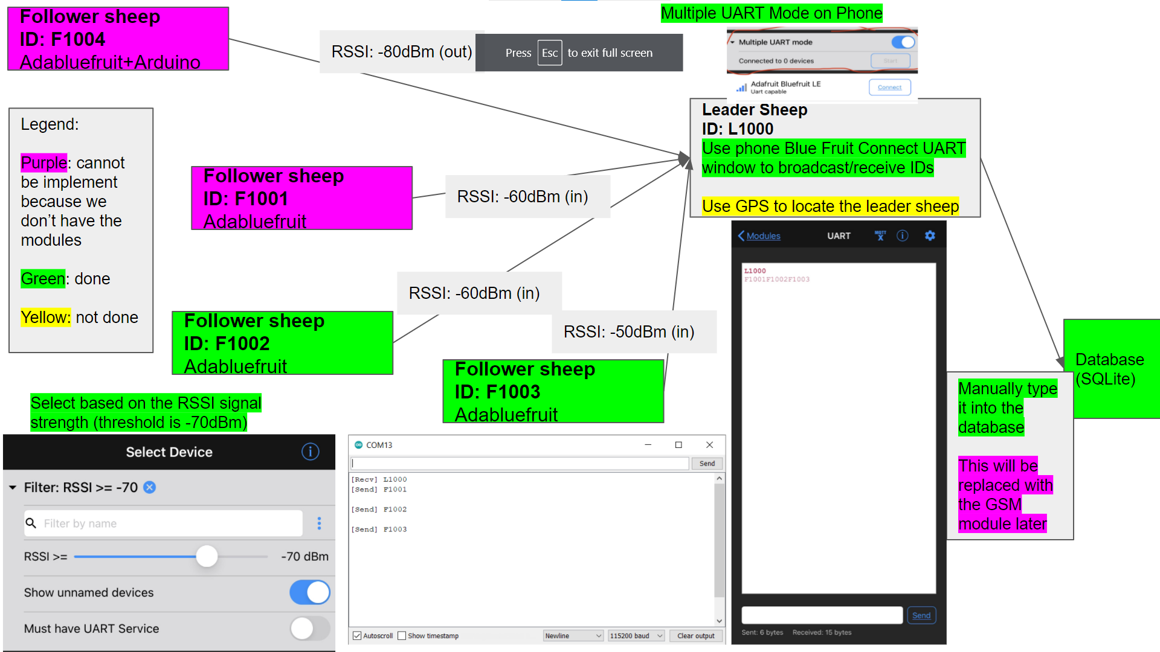

Slide 3
Process
Follower Sheep 2
Phone 1
Leader Sheep
GPS
Phone 2
Leader Sheep UART communication
Follower Sheep 1
Backend Database
Leader sheep sends GPS information to backend constantly
Leader sheep pings follower sheep
Follower sheep sends id to leader sheep
Follower sheep passes on sheep id to backend (Haven't done)

Slide 4
Process
Follower Sheep 2
Phone 1
Leader Sheep
GPS + sheep ids UART
Phone 2
Leader Sheep UART communication
Follower Sheep 1
Backend Database
Leader sheep pings follower sheep
Follower sheep sends id to leader sheep
Leader sheep gets GPS information constantly
Follower sheep passes on sheep id and GPS to backend

Slide 6
I made the graph in google slides, here is the link https://docs.google.com/presentation/d/19Iph4xwfol5bO7mSApgiykuRJZWlmiYWaz3clUHB9hw/edit?usp=sharing

Slide 7
Front End Leader Sheep
GPS + multiple UART mode/(in the future use a different protocol)
Broadcast leader sheep ID: L1000/L2000/L3000
Receives/stores the response from close follower sheep (F1001, F1002, F1003)
GPS module to locate the leader sheep
Send the info to the back end: [“GPS: 14.2220, 20.1110”, “F1001F1002F1003”]

Slide 8
Front End Follower Sheep
Adabluefruit + Arduino + PC
Once receive the broadcast from the closest leader sheep, send the follower sheep ID through the serial monitor to the leader sheep
RSSI need some testing on distance/connectivity (someone do this)
This is done on PC right now, but in the future, should be implemented independently.

Slide 9
Back End Database + Missing Sheep Report
SQLITE database + missing sheep finding algorithm
From the leader sheep (cell phone UART monitor), we need to type the information to the database manually right now because we don’t have GSM module
Missing algorithm description see next page

Slide 10
UI Sheep-Link
Sheep_Link
Real_time Database
Missing SheepAlert
Missing sheep _

Slide 11
Read from the Monitor
Write to the SHEEPs db
From the SHEEPs db, detect missing and write missing sheep IDs to the MISSING db
Load the MISSING sheep db to the UI (tut used a load button, idk how to real time update)

